Slide 1
RENEWABLE ENERGY SOURCE
UNIT 1: Energy sources

Slide 2
per capita energy consumption:
Though India accounts for around 18% of world's population, it uses only around 6% of the world's primary energy.
The Per Capita Electricity Consumption which was a mere 16.3 units in 1947, has increased to 1181 units in 2018-19. (http://www.cea.nic.in/reports/others/planning/pdm/growth_2019.pdf)

Slide 3
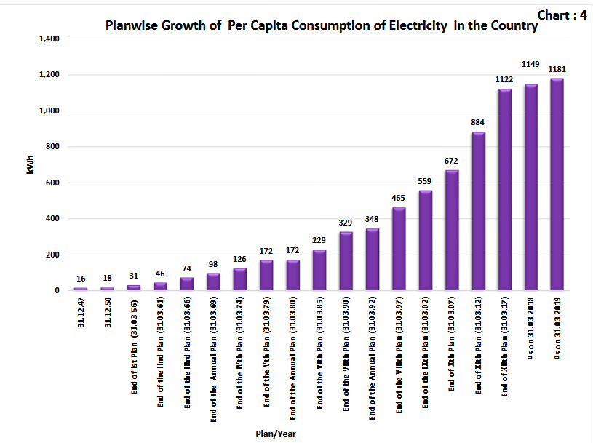

Slide 4
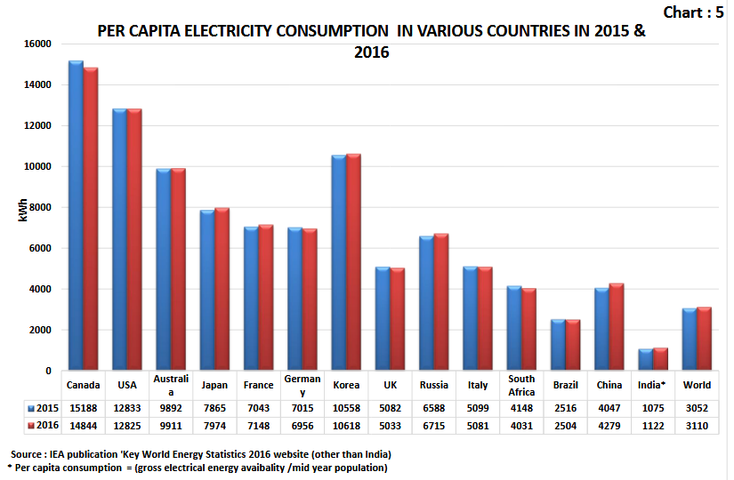

Slide 5
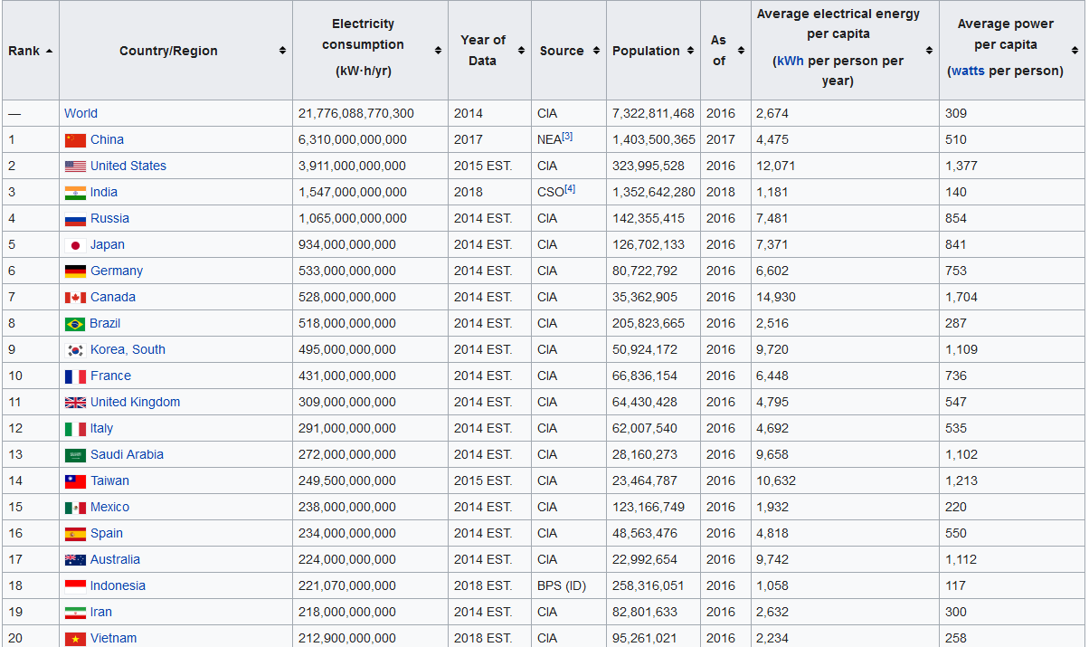
Source: https://en.wikipedia.org/wiki/List_of_countries_by_electricity_consumption

Slide 6
Classification of energy resources:
Primary and Secondary energy
Commercial & Non-Commercial Energy
Renewable & Non renewable Energy

Slide 7
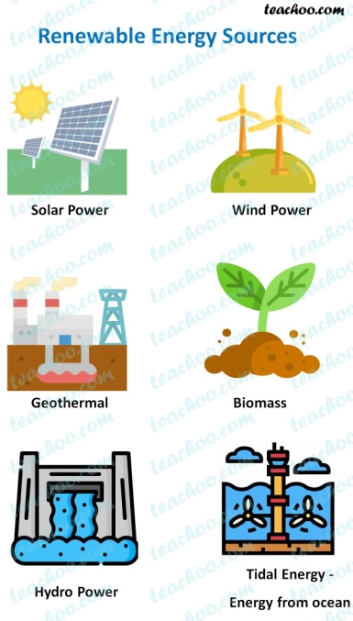
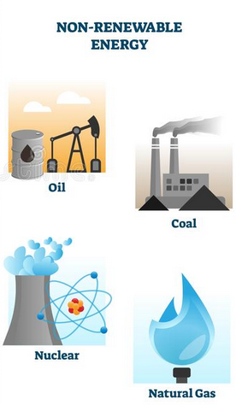
Primary and Secondary energy
Primary energy sources refers to energy extracted or captured directly from natural resources
Renewable Energy
Solar
Wind
Non Renewable Energy
Crude oil
Natural gad
Tidal
Geothermal
Biomass
Hydel
etc
coal
Nuclear
Etc.

Slide 8
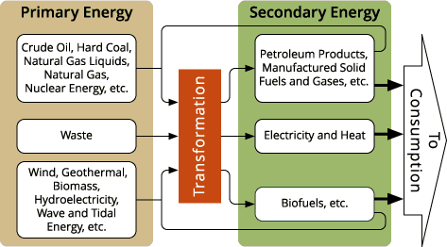
Secondary energy Resource:
The primary energy resource is transformed into a more convenient form of energy such as electricity, steam, etc.
This form of energy is called secondary energy resource.

Slide 9
Commercial & Non-Commercial Energy
The sources of energy that are available to the consumer at some price are referred to as commercial energy.
The sources of energy that are usually availably free of cost to the users are referred to as non-commercial energy (traditional fuels)
commercial energy
coal
Petroleum
non-commercial energy
fire wood
Straw
natural gas
electricity
agricultural waste
cow dung

Slide 10
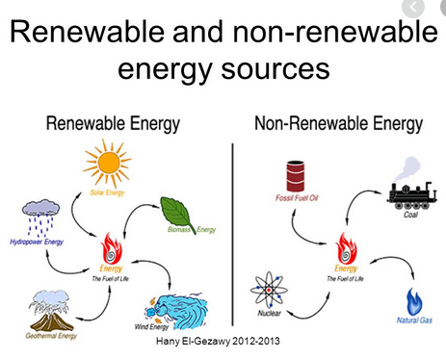
Renewable & Non renewable Energy
Renewable energy is the energy obtained from natural sources which are inexhaustible. They are harnessed without the release of harmful pollutants.
Non renewable Energy resource is a natural resource which cannot be produced, grown or replenished.

Slide 11
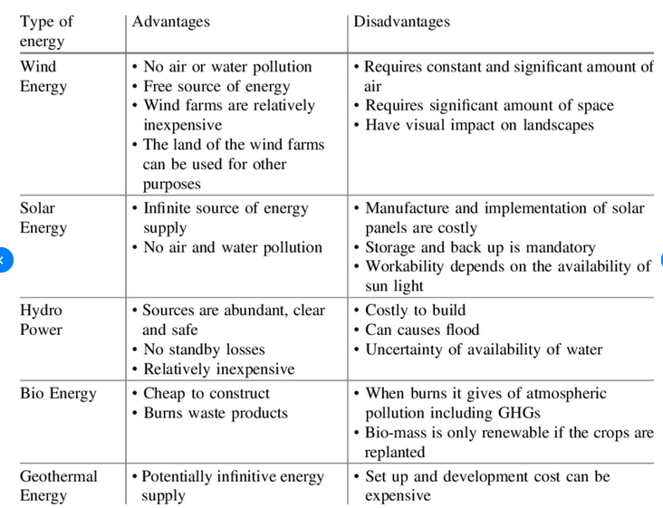
Advantages & limitations of verious Energy Resources:

Slide 12
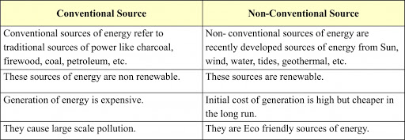
comparison of conventional and non-conventional energy resources

Slide 13
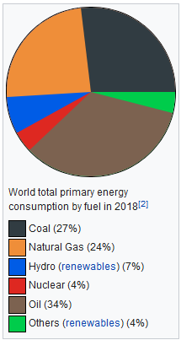
world energy scenario

Slide 14
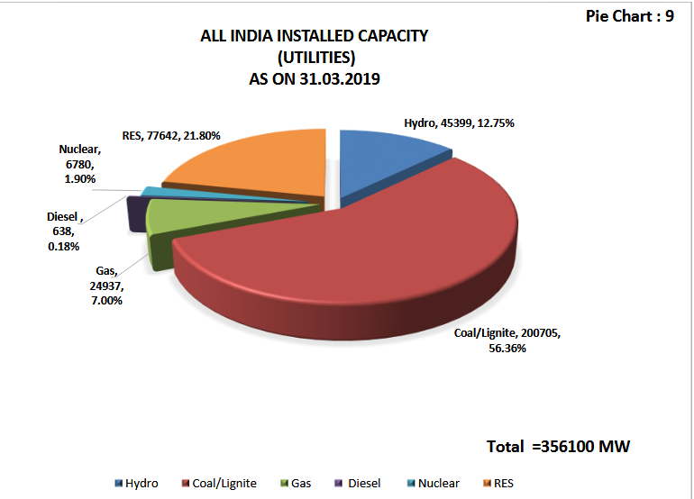

Slide 15
